Slide 1

Document Layout Analysis via Machine Learning
Prepared By: Liang XuChao
Supervisor: Dr Loke Yuan Ren
Examiner: Lu Shijian

Slide 2
01
Introduction
02
Literature Review
03
Implementation
Agenda
04
Result Summary
05
Conclusion

Slide 3
Introduction
Background
Motivation and Objective

Slide 4
Background
“What is document layout analysis?”
A form of object detection to categorizing and detecting different layout in a document, such as text, tables, and figures
“How should I detect objects in a picture?”
Train a detection model through machine learning

Slide 5
Background
“How to train a model for document layout analysis?”
Data Preparation
Training Technic
“What is the definition of a good model?”
Prediction Analysis
Compare and Contrast

Slide 6
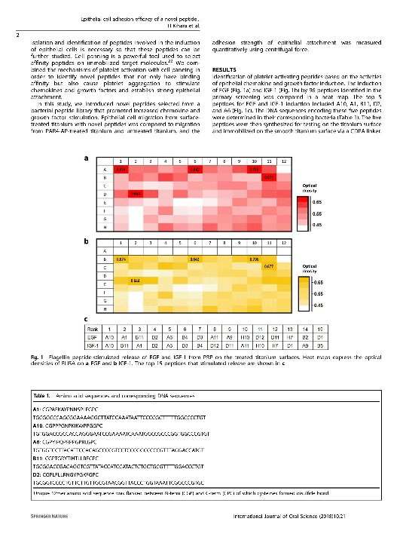
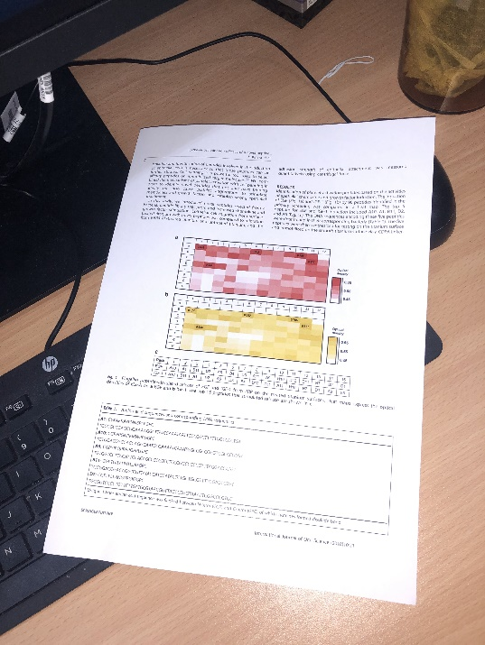
Motivation & Objective
Existing solutions for DLA often perform well on one type of digital document but struggle when presented a layout that is completely different
Existing solutions usually work poorly on documents which capture as a photo
Build a generic model using machine learning technic to detect documents in different layout format and able to predict on both scanned and photo taken document image

Slide 7
Literature Review
Existing Solution
Available Dataset

Slide 8
Existing Solutions
Model | Architecture | Output | Accuracy | Speed
YOLO | CNN + Grids + Bounding Box | Object Bounding Boxes | Moderate - High | Very Fast
Faster-RCNN | CNN + RPN | Object Bounding Boxes | High | Moderate
Mask-RCNN | CNN + RPN | Object Bounding Boxes + Masks | High | Moderate
LayoutLM | BERT-based + Vision CNNs | Document Structure Info | High | Moderate

Slide 9
Available Dataset
Dataset | Size | Type of document | Scanned or Camera taken | Annotation | Layout Category | Remark
PubLayNet | 360K | Scientific paper | Scanned | Bounding Box and segmentation | 5 | Single type of document. Only a few of layout category.
DocLayNet | 80K | Financial, Scientific, Patents, Manuals, Laws, Tenders | Scanned | Bounding Box and segmentation | 11 | Better choice for training with variety types of document and layout category
DocBank | 500K | Financial and Scientific paper | Scanned | Bounding Box | 12 | Large dataset but only a few type of document. Annotation is not accurate after verify multiple images.
WarpDoc | <1000 | Scientific Paper | Camera taken | Nil | Nil | Not suitable for training layout model as no annotation provided. It can be used for prediction on camera taken documents.

Slide 10
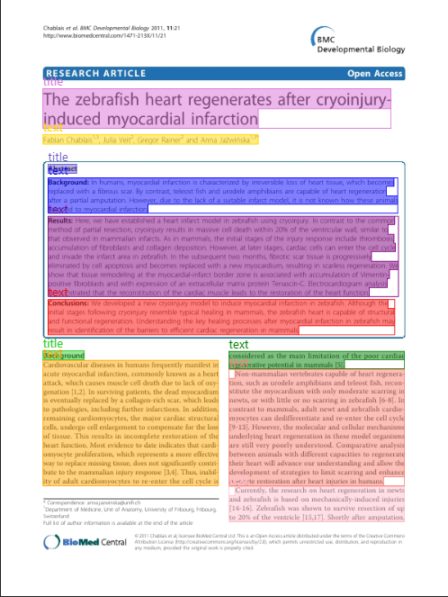
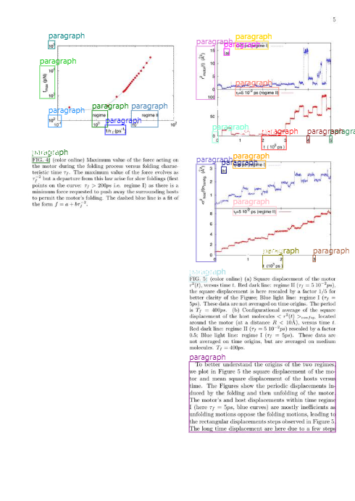
Available Dataset
Missing Annotation
Incorrect annotation
PubLayNet
DocBank

Slide 11
Implementation
Design
Training Setup

Slide 12
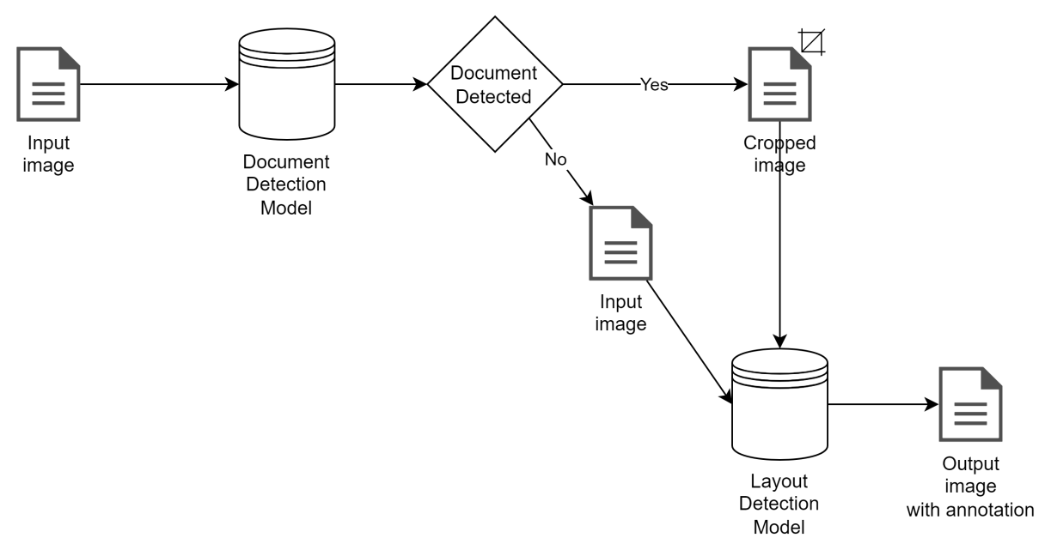
Design

Slide 13
Training Setup
Hardware
Device | Windows PC
RAM | 16GB
CPU | Intel(R) Core(TM) i7-8700 CPU @ 3.20GHz
GPU | RTX 2060 @ 6GB RAM
Software tool
Programming language | Python
Framework | Detectron2 and Pytorch
GPU tool kit | CUDA toolkit match PyTorch version

Slide 14
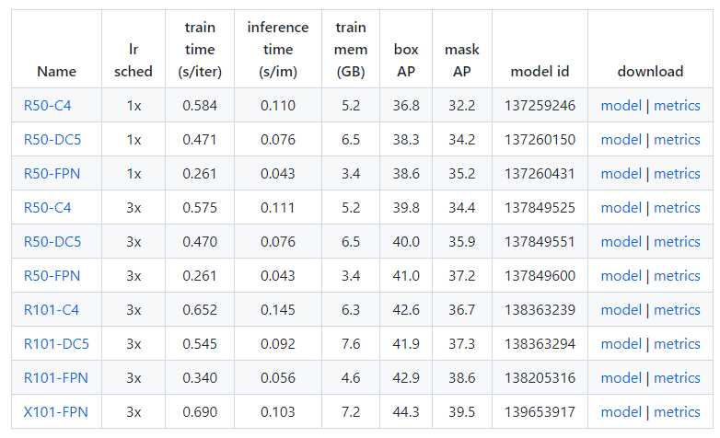
Training Setup
Baseline model for Mask-RCNN
Table 4: Base Lines model provided by Detectron2 with Mask R-CNN

Slide 15
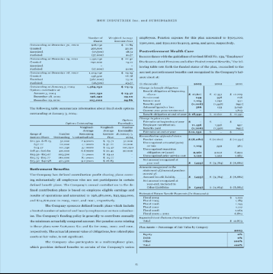
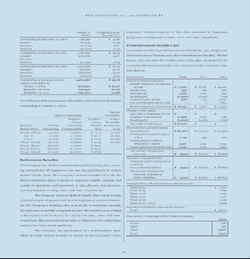
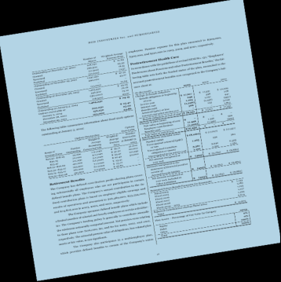
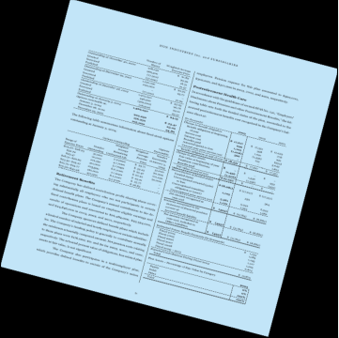
Training Setup
Pre-Processing
To enhance the model's ability to detect document layouts in photo-taking form, the original dataset, which consists only of digital documents, may not be sufficient. Hence Image augmentation is applied randomly in each training iteration.
Original
Brightness
Anti-clockwise Rotation
Clockwise Rotation

Slide 16
Training Setup
Layout Detection Model
Category | Item count
Caption | 19218
List-item | 161818
Picture | 39667
Text | 431251
Footnote | 5619
Page-footer | 61313
Section-header | 118590
Title | 4437
Formula | 21167
Page-header | 47973
Table | 30070
Total | 941123
Parameter | Value
Base line model | mask_rcnn_R_101_FPN_3x
Number of Class | 11
Image per Iteration | 1
Iteration | Per training >= 60000 Final iteration = 1460000
Learning Rate | 0.00025
Training parameter for Layout Model
DocLayNet train set category summary

Slide 17
Training Setup
Document Detection Model
Parameter | Value
Base line model | mask_rcnn_R_101_FPN_3x
Number of Class | 1
Image per Iteration | 1
Iteration | 80000
Learning Rate | 0.00025
Category | Item count
Document | 50
WarpDoc manual label train set category summary
Training parameter for Document Model

Slide 18
Result Summary
Evaluation AP on IOU
Prediction Experiment

Slide 19
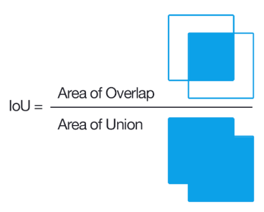
Evaluation AP on IOU
Evaluation result metric will use the IoU value to calculate the Average Precision (AP) for each category.
The AP will use the 10 threshold IoU value: 0.5, 0.55, 0.6, 0.65, 0.7, 0.75, 0.8, 0.85, 0.9, 0.95 and average the output value.

Slide 20
Evaluation AP on IOU
Layout Detection Model
Category | Item Count
Caption | 1763
List-item | 13320
Picture | 2775
Text | 49186
Footnote | 312
Page-footer | 5571
Section-header | 15744
Title | 299
Formula | 1894
Page-header | 6683
Table | 2269
Total | 99816
Category | mAP (segmentation) | mAP (bbox) | mAP (bbox) (Result from DocLayNet official paper)
Caption | 72.100 | 71.970 | 71.5
List-item | 67.131 | 64.659 | 80.8
Picture | 77.699 | 77.225 | 72.7
Text | 79.288 | 77.603 | 85.8
Footnote | 55.761 | 55.656 | 71.8
Page-footer | 50.034 | 48.761 | 59.3
Section-header | 58.545 | 57.685 | 70.0
Title | 55.513 | 53.664 | 80.4
Formula | 53.937 | 52.739 | 63.4
Page-header | 62.780 | 62.205 | 70.0
Table | 78.413 | 77.415 | 82.9
DocLayNet test set category summary
mAP on the 11 categories.

Slide 21
Evaluation AP on IOU
Layout Detection Model
mAP (over 10 threshold) bbox | AP50 bbox | AP75 bbox | AP (over 10 threshold) segmentation | AP50 segmentation | AP75 segmentation
63.598 | 86.445 | 71.208 | 64.655 | 86.420 | 72.469
Overall Average Precision

Slide 22
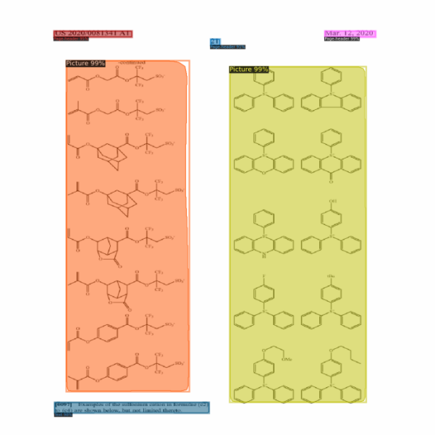
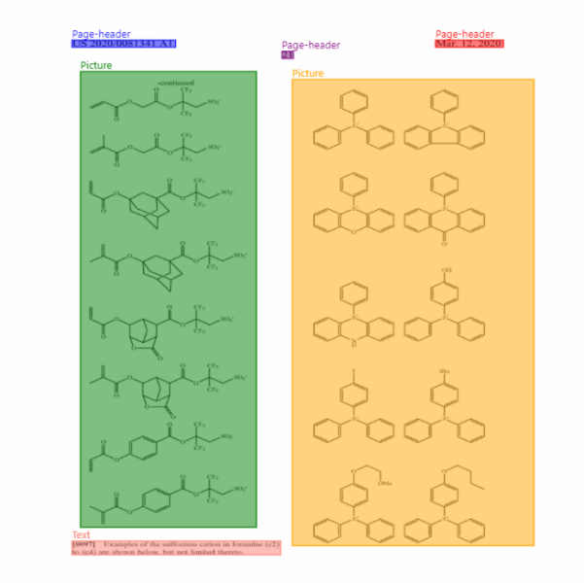
Prediction Experiment
Prediction on DocLayNet dataset
Predict
Actual

Slide 23
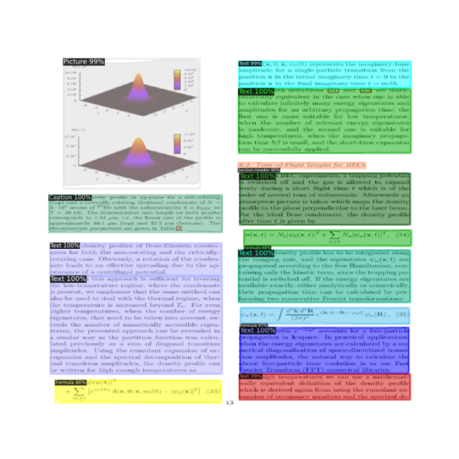
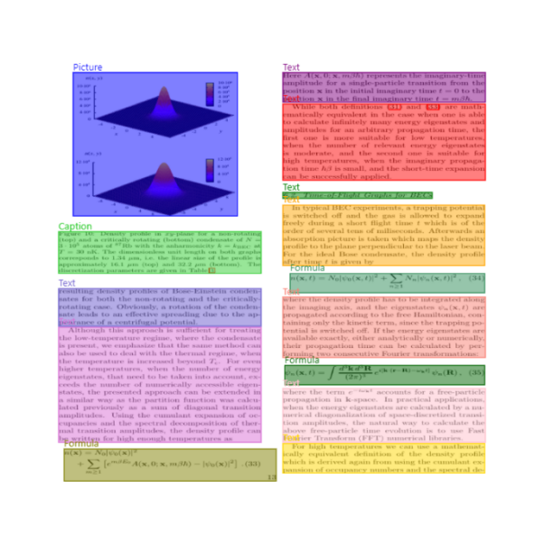
Prediction Experiment
Prediction on DocLayNet dataset
Predict
Actual

Slide 24
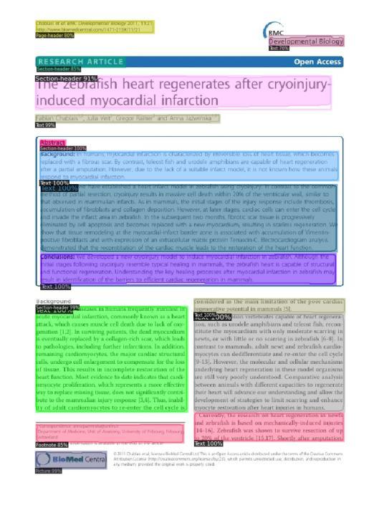
Prediction Experiment
Prediction on PubLayNet dataset
Predict
Actual

Slide 25
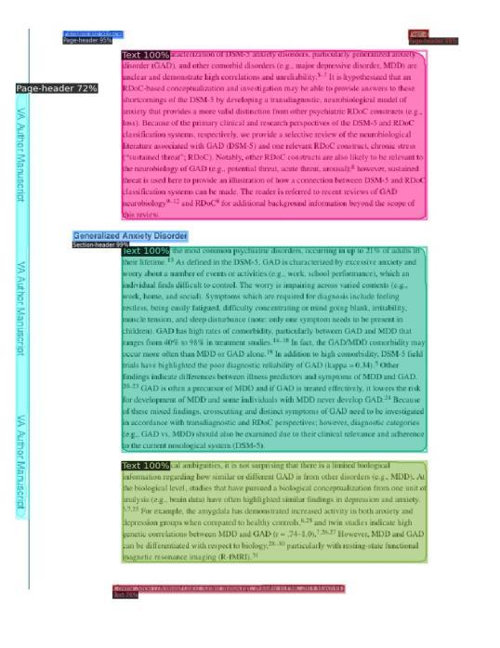
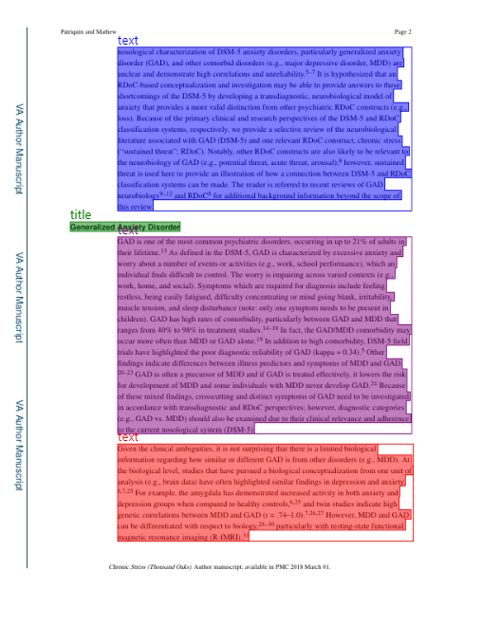
Prediction Experiment
Prediction on PubLayNet dataset
Predict
Actual

Slide 26
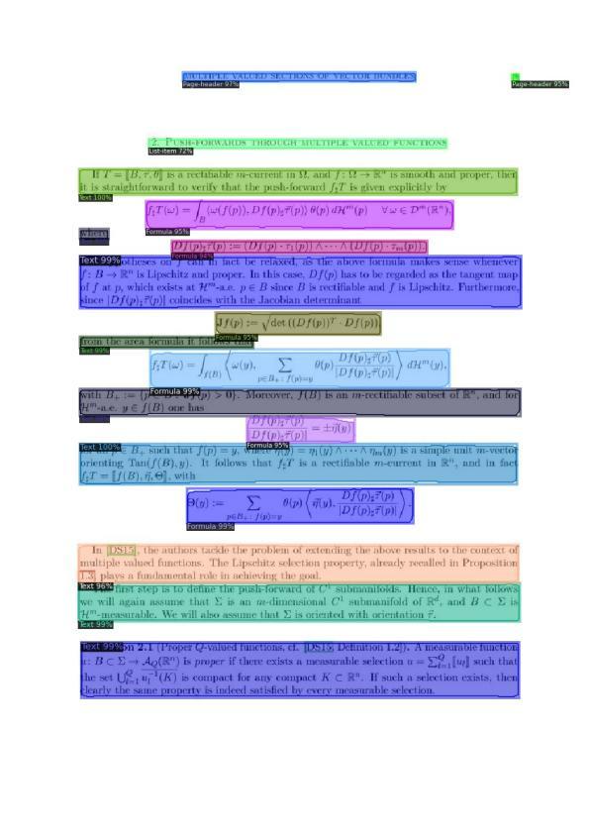
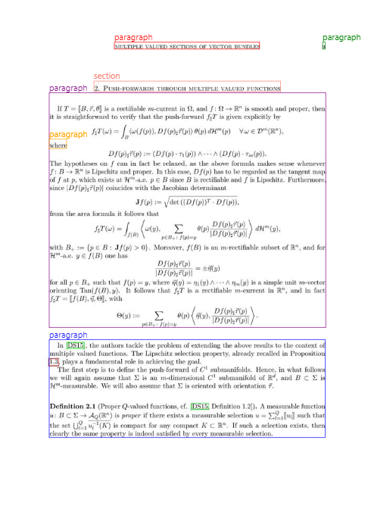
Prediction Experiment
Prediction on DocBank dataset
Predict
Actual

Slide 27
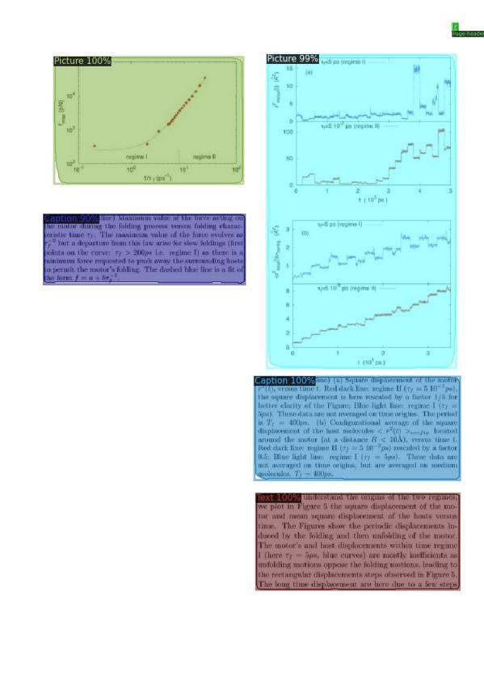
Prediction Experiment
Prediction on DocBank dataset
Predict
Actual

Slide 28
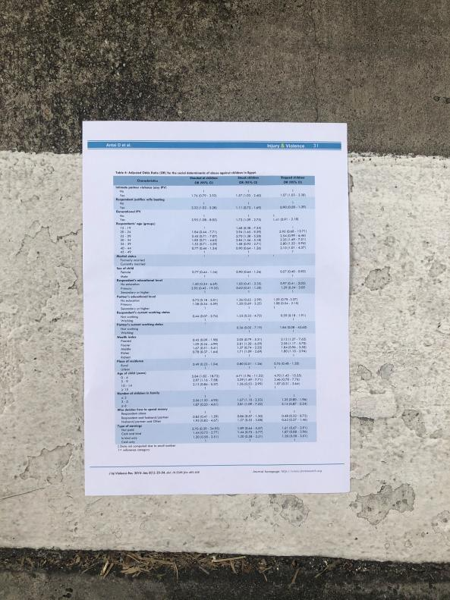
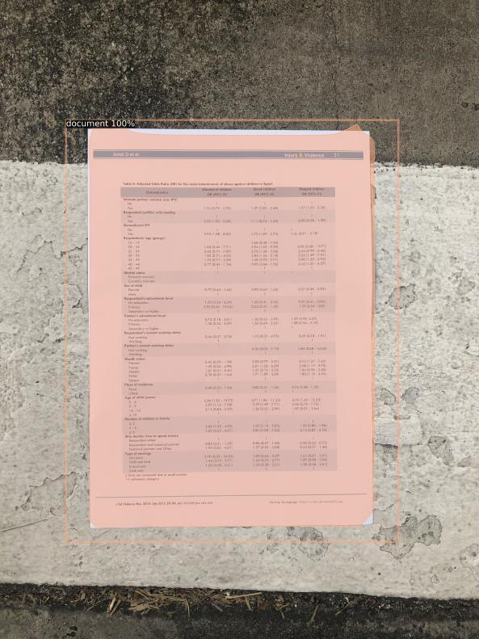
Prediction Experiment
Prediction on Photo Taking Document Images
Original
Detection on entire Document using Document Model

Slide 29
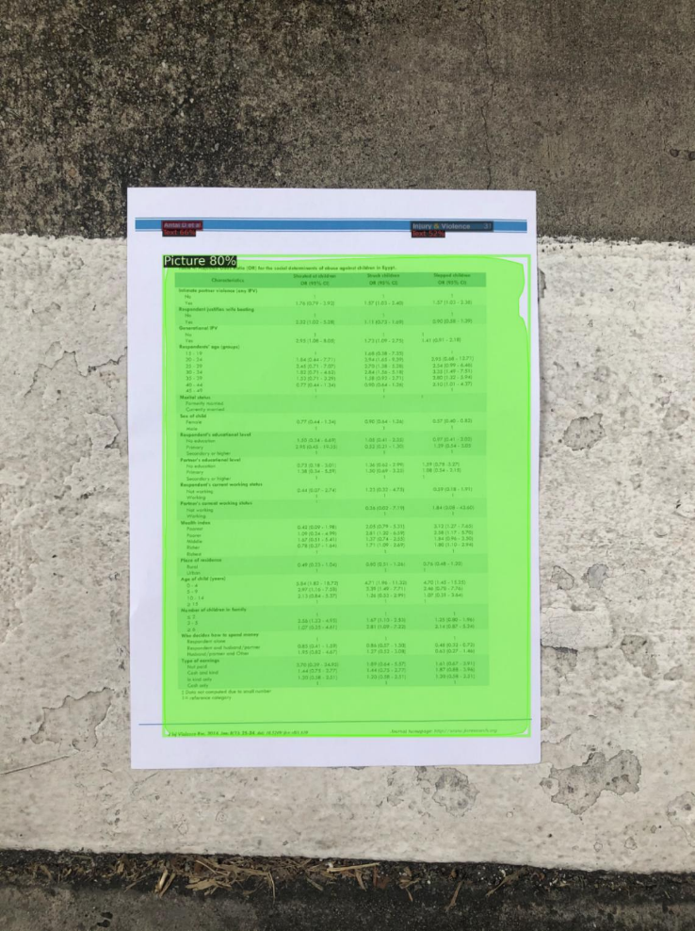
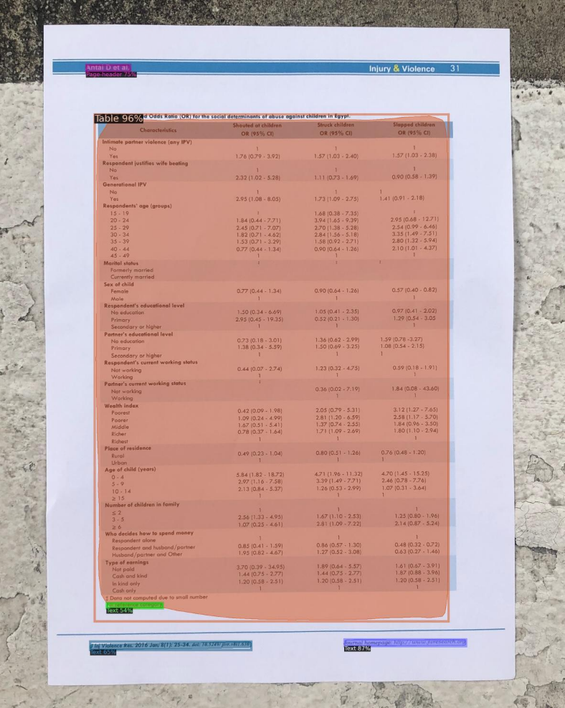
Prediction Experiment
Prediction on Photo Taking Document Images
Layout prediction on the original image
Layout prediction on the cropped document image

Slide 30
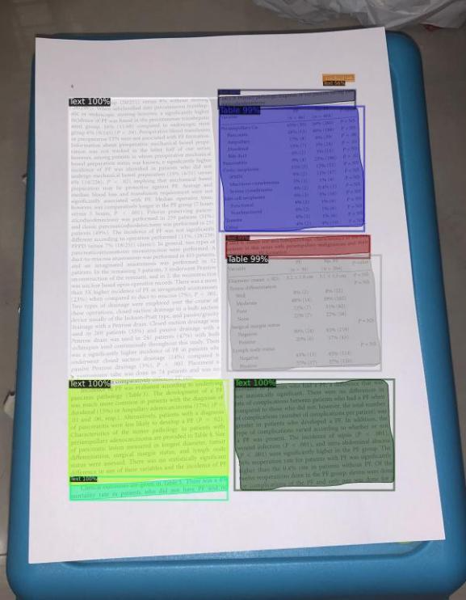
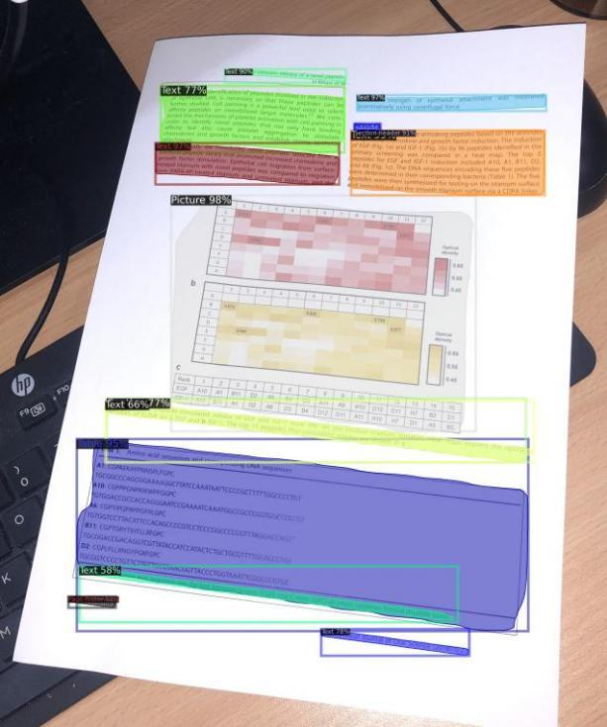
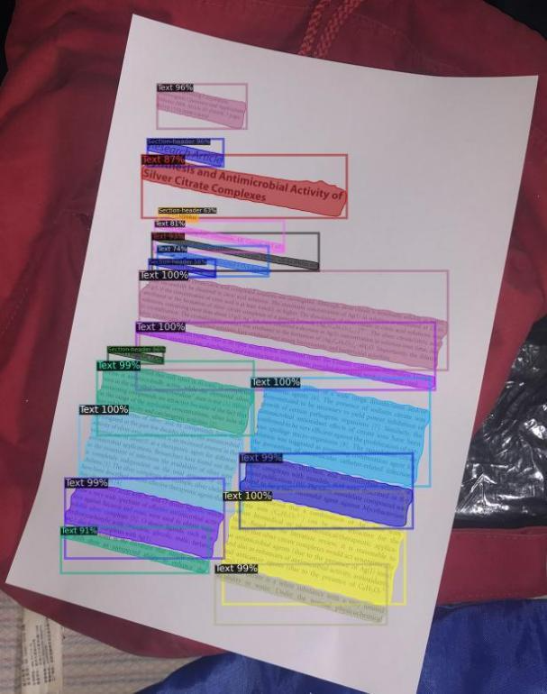
Prediction Experiment

Slide 31
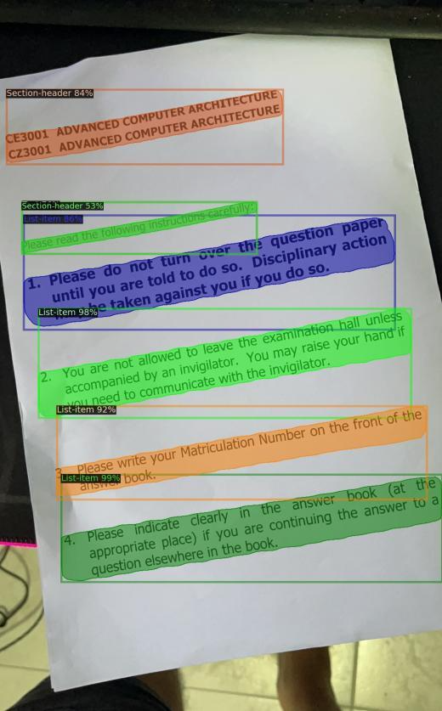
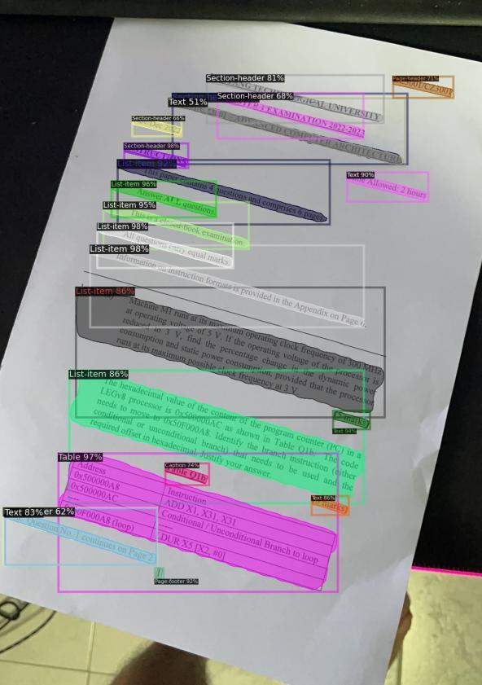
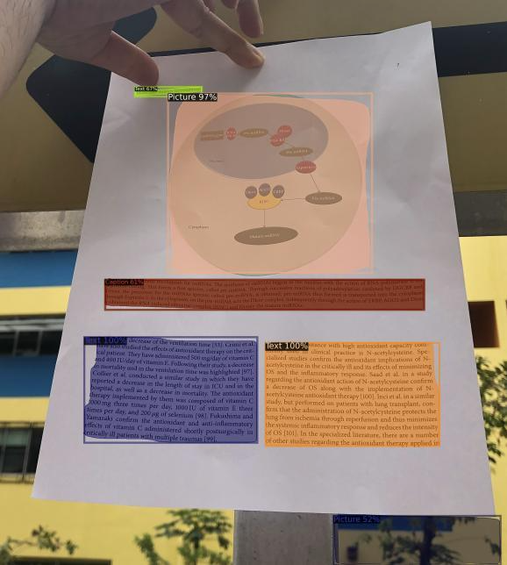
Prediction Experiment

Slide 32
Conclusion
Project Summary
This project built a document layout detection model using deep learning techniques in Mask R-CNN approach. The final model achieved an average 86% on AP50, with each category having a minimum 50% on AP50.
Project Limitations
Although the model is designed to detect any type of document, it is more suitable for research papers or articles. The model may require additional fine-tuning for other types of documents such as invoice, magazine and many more.
Future Enhancement
To enhance the accuracy and efficiency of document layout detection, future studies may consider introducing new models, each targeting a different document type. The application of model assembly methods can be utilized to provide the most accurate result by utilizing the strengths of each model.

Slide 33
Demo

